Slide 1
ECSE 211
Design Principles and Methods
TEAM 2

Slide 2
Team Members and Roles
Ali Sharif | Julien Courbebaisse | Philippe Papineau | Romain Nith | Rami Djema | Nayem Alam
U2 Electrical Engineer | U3 Software Engineer | U1 Electrical Engineer | U3 Computer Engineer | U2 Software Engineering | U1 Electrical Engineering
Lead Tester, Software Developer | Lead Software | Lead Documenter, Hardware help | Lead Hardware | Software Developer | Project Management
Document | Document | Document | Document | Document | Document

Slide 3
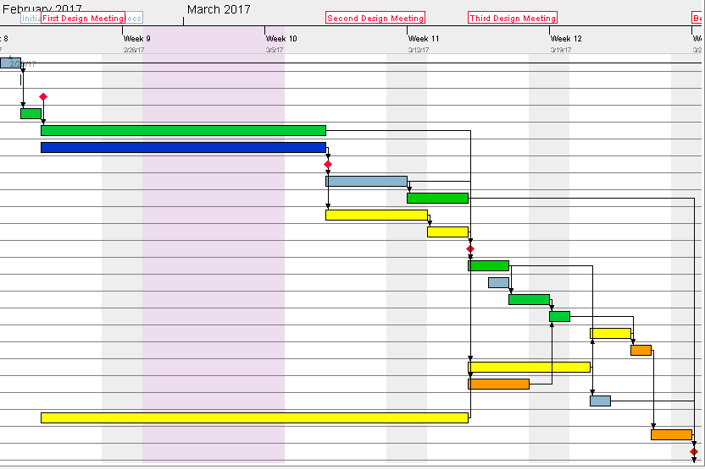
Design Proposal
Meetings with Prof
Documentation (KEY)
Complete mechanical design
Software class hierarchy
Gantt Chart?
A timeline that displays tasks/events with time

Slide 4
General Overview
Purpose: Construct an autonomous robot that can:
Localizing itself
Figure out what position to play (forward/defense)
Navigate itself around the 12x12 floor, and 8x10 field
Avoiding obstacles
Throw ball at the target

Slide 5
Constraints
Limit of 54 man-hours per week.
Software limitations created due to limitations in LeJOS library. Not enough time present to rewrite from scratch.
Low rigidity of the lego connectors will cause flex in the wheel axles.
High powered motor with fine tuned control for the ball launcher’s motor is not available by default in LeJOS
Environmental noise affecting our sensors. Can’t rely on absolute values.
Ultrasonic sensor is highly susceptible to noise and false positives due to irregular geometry.
Light sensor measurements are relative to ambient light.
Can’t use advanced materials such as carbon fiber.

Slide 6
Requirements
Purpose: A robot that is able to assume it’s position on the field, localize and navigate itself and avoid collisions.
Scope:
12’X12’ floor (8’X10’ field)
30 seconds to localize
3 rounds (2 rounds are forward and defense, 3rd play forward)-7min/round
3rd round: series of obstacles placed in the forward zone
Instruction via WiFi
3 Mindstorm Kits (Set of Components)
Size of robot: no restrictions

Slide 7
System
Hardware Availabilities/Capabilities:
3 DPM EV3 Lego Kit
Sensors limited by their refresh rate and accuracy
Motors limited by their max torque and speed output
Software Availabilities/Capabilities:
Reusing Lab 1-5 (edit and add extra)
Github for version control and separating tasks into modules
3 software contributors
eGit (Eclipse plugin) to make multiple people work on a code simultaneously

Slide 8
Initial Design: rough sketch
(See drawings for the three prototypes)

Slide 9
Plan for the upcoming weeks
Construct 3 mechanical designs, choose one design as a team
Identify initial design problem: come up with an efficient solution
Start developing the software to support the mechanical design
Document every step thoroughly and accordingly
Weekly team meetings + communication through Facebook Group, Chats, Google docs...
Meet T.A every tuesday (3:00pm), prepare questions that may be useful to the project

